Slide 1
ASP.NET Core
21.01.2019

Slide 2
About me
ASP.NET, C# Developer
5 years software engineer experience
More then 10 project
ASP Classic
Web Forms
MVC
.Net Core

Slide 3
Summary
Intro
History
.Net Standard
CLI (command line tooling)
Project structure

Slide 4
Summary
Fundamentals
Startup and Middleware
Application configuration
Logging
Dependency injection
Host
Web servers
Diagnostics
Handle errors
Static files
URL Redirect/Rewriting
Localization and Globalization
In Memory Caching (a.k.a local cache)

Slide 5
Summary
Web App
MVC
Work with MVC Views and Razor Pages
Api Controllers
Tag Helpers

Slide 6
Summary
Testing MVC App

Slide 7
Intro

Slide 8
History
https://dotnetcore.gaprogman.com/2018/02/23/net-core-history/
https://dotnetcore.show/episode-1-a-brief-history-of-net-core/
https://mattwarren.org/images/2018/10/History%20of%20.NET%20Runtimes%20-%20Timeline.png

Slide 9
What is .Net Core
Open-Source
Cross-platform
Web applications, IOT apps and mobile backends
Cloud ready
Performance
Built-In Dependency Injection

Slide 10

What is .Net Core
.NET FRAMEWORK
WINDOWS UWP
.NET CORE
ASP.NET
DESKTOP
XAMARIN
CLOUD
MOBILE
TOOLS
Visual Studio
.NET STANDARD LIBRARY
Visual Studio for Mac
COMMON INFRASTRUCTURE
Visual Studio Code
Compilers
Languages
Runtime components

Slide 11
.NET Standard
.NET Standard is a specification
A set of APIs that all .NET platforms have to implement
.NET Standard
.NET Framework
.NET Core
Xamarin
~
~
HTML specification
Browsers

Slide 12
.NET Standard
https://github.com/dotnet/standard/blob/master/docs/faq.md
https://github.com/dotnet/standard/blob/master/docs/metaphor.md
https://apiof.net
https://github/dotnet/standard
https://icanhasdot.net
https://packagesearch.azurewebsites.net
https://github.com/dotnet/standard/blob/master/docs/versions.md

Slide 13
.NET Core vs .NET Framework
Similarities
Support the latest C#, VB.NET, F#
Implements .NET Standard API
Supports ASP.NET Core and EF Core
Best experience in Visual Studio
Great experience in Visual Studio Code
Can be used in/with Docker

Slide 14
.NET Core vs .NET Framework
Differences
.NET Framework comes with Windows
.NET Core installs side-by-side
.NET Core is cross-platform and OSS
.NET Core works on Nano
.NET Core has a strong CLI experience

Slide 15
Command | Purpose
dotnet new | Initialize .NET projects.
dotnet restore | Restore dependencies specified in the .NET project.
dotnet run | Compiles and immediately executes a .NET project.
dotnet build | Builds a .NET project.
dotnet publish | Publishes a .NET project for deployment (incl. runtime).
dotnet test | Runs unit tests using the test runner specified in the project.
dotnet pack | Creates a NuGet package.
dotnet migrate | Migrates project.json project to msbuild based project.
Notes:
https://github.com/dotnet/cli Command Line Interface

Slide 16
Command | Purpose
dotnet clean | Clean build output(s).
dotnet sln | Modify solution (SLN) files.
dotnet add | Add reference to the project.
dotnet remove | Remove reference from the project.
dotnet list | List reference in the project.
dotnet nuget | Provides additional NuGet commands.
dotnet msbuild | Runs Microsoft Build Engine (MSBuild).
dotnet vstest | Runs Microsoft Test Execution Command Line Tool.
Notes:
https://github.com/dotnet/cli

Slide 17
Fundamentals

Slide 18
Middleware
HTTP Module / MVC Filters
Middleware

Slide 19
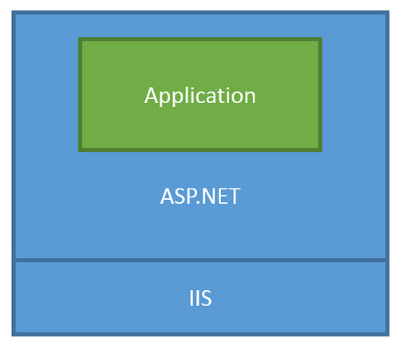
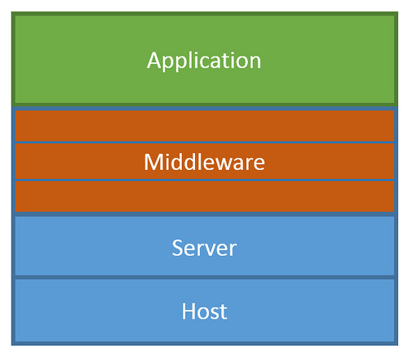
Middleware
Traditional ASP.NET Application Model
ASP.NET Core Middleware

Slide 20
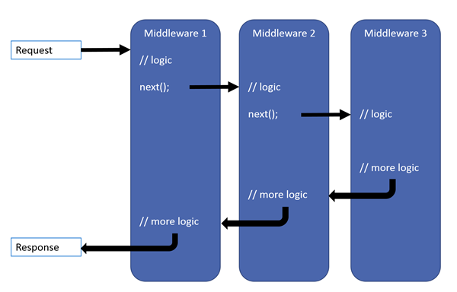
Middleware
Notes:
ordering is important

Slide 21
Configuration
Configuration providers
Key-value pairs
Keys are case-insensitive
Same key is set by same or different configuration => LAST
Values are strings.
Null values can't be stored in configuration or bound to objects.
Notes:
Each source with specific provider

Slide 22
Configuration
Sources
Azure Key Vault
Command-line arguments
Custom providers (installed or created)
Directory files
Environment variables
In-memory .NET objects
Settings files
Notes:
Each source with specific provider

Slide 23
Configuration
Providers
File Configuration Provider
Azure Key Vault Configuration Provider
User secrets
Environment Variables Configuration Provider
Command-line Configuration Provider
Custom configuration provider
Key-per-file Configuration Provider
Memory Configuration Provider

Slide 24
Configuration
Microsoft.Extensions.Configuration

Slide 25
Logging
Console
Debug
EventSource
EventLog
TraceSource
Azure
Notes:
logging.AddConsole(); // by default in CreateDefaultBuilder
logging.AddDebug(); // by default in CreateDefaultBuilder
logging.AddEventSourceLogger(); // by default in CreateDefaultBuilder
ClearProviders

Slide 26

Dependency Injection

Slide 27
Dependency Injection
Autofac
Ninject
StructureMap
many others

Slide 28
Dependency Injection
Transient
Scoped
Singleton

Slide 29
Dependency Injection
Microsoft.Extensions.DependencyInjection
Notes:
Separate package and can be used in other type of application

Slide 30
Host
Web Host
Generic Host(2.1)
=> Web apps.
=> Non-web apps
Notes:
ASP.NET Core apps configure and launch a host. The host is responsible for app startup and lifetime management. At a minimum, the host configures a server and a request processing pipeline.
The Generic Host will eventually replace the Web Host.

Slide 31
Host
Web Host
IWebHostBuilder

Slide 32
Host
Generic Host
IHostBuilder
Notes:
The goal of the Generic Host is to decouple the HTTP pipeline from the Web Host API to enable a wider array of host scenarios.

Slide 33
Server
Kestrel
HTTP.sys -> WebListener
=> Cross platform
=> Windows

Slide 34


Server
Notes:
Kestrel is generally recommended for best performance.

Slide 35
Server
Custom servers
OWIN

Slide 36
Handler errors

Slide 37
MVC

Slide 38
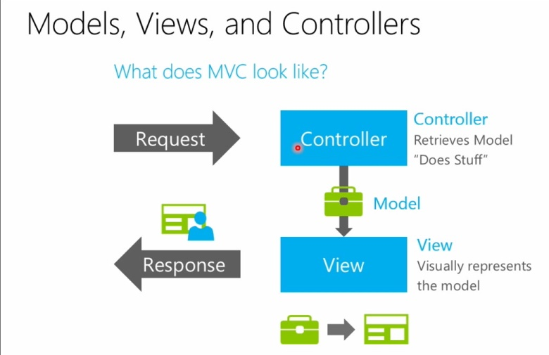
All about MVC

Slide 39
Razor pages
@page
Pages – folder
OnGet
OnPost
XSRF/CSRF – by default
Notes:
Example with dependency injection into view
Filters https://docs.microsoft.com/en-us/aspnet/core/razor-pages/filter?view=aspnetcore-2.1

Slide 40
Tag Helpers
Tag Helpers enable server-side code to participate in creating and rendering HTML elements in Razor files.

Slide 41
Controller & Api

